Slide 1
Automated Meeting Room Booking System
MEMBERS-
SIDDHI SHARMA SHIVENDRA PRATAP SINGH SHUBH SHARMA
PRIYANSHU PRASAD DIVYA PARKHI KRITI BHAWSAR
VEDANG KULKARNI AYUSHI THAKUR

Slide 2
INTRODUCTION
In today's fast-paced corporate world, time is of the essence, and every minute counts.
Meetings are a vital part of collaboration and decision-making within a company, but the process of booking meeting rooms can often be a tedious and time-consuming task.
That's where our Automated Room Booking System steps in to revolutionize the way of booking meeting spaces.

Slide 3
PROJECT FEATURES
User-friendly interface for effortlessly creating and configuring meeting rooms.
Managers can easily search for and book meeting rooms that match their specific meeting requirements.
System prevents double bookings, reducing scheduling conflicts and enhancing efficiency.
Intuitive and user-friendly interface that makes the system accessible to all users, regardless of their technical proficiency.
Real-time room availability to Managers, allowing them to make informed booking decisions.

Slide 4
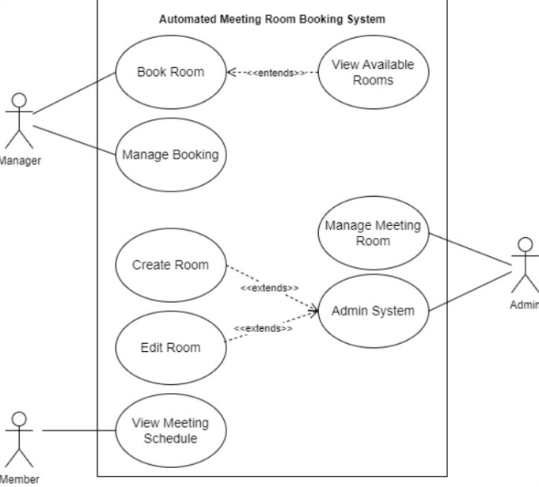
USE CASE DIAGRAM

Slide 5
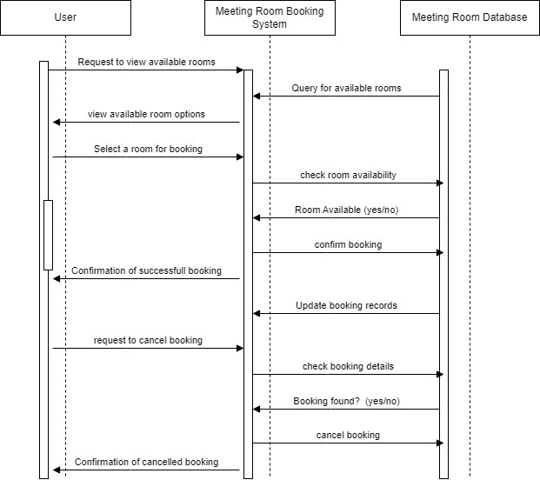
Class Diagram

Slide 6
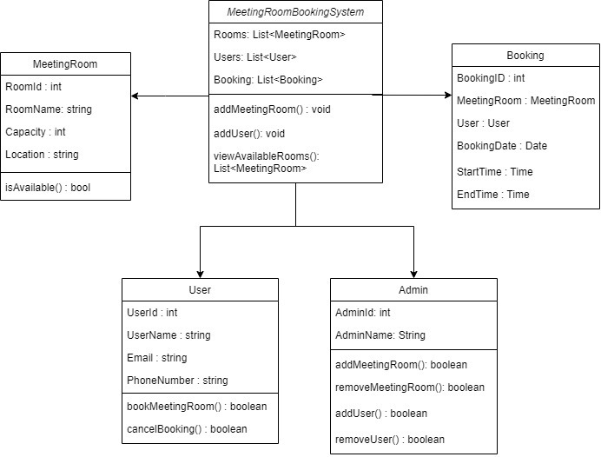
Sequence Diagram

Slide 7
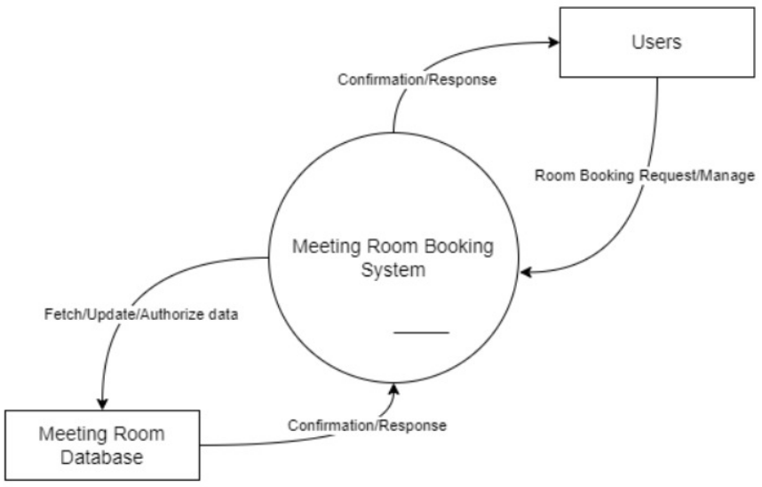
CONTEXT DIAGRAM

Slide 8
TECHNOLOGIES USED
Spring Tool Suite
Java
JavaScript
VS Code
Github
HTML/CSS

Slide 9
USER ROLES
Admin - Creates and configures meeting rooms.
Managers - Search and books a room for a meeting.
Members - Part of a meeting

Slide 10
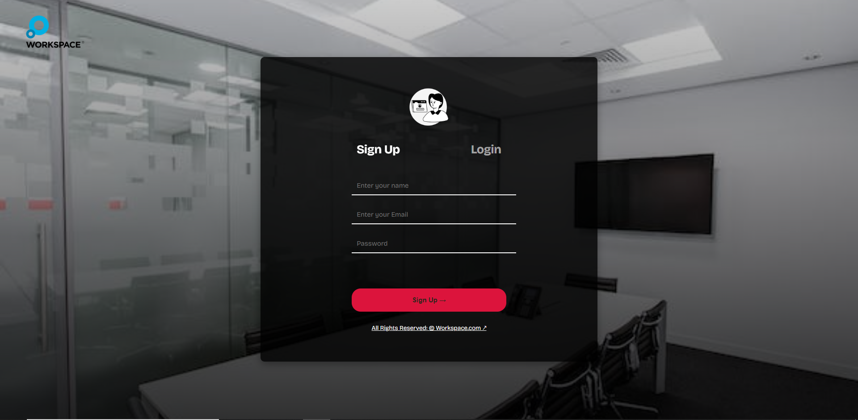
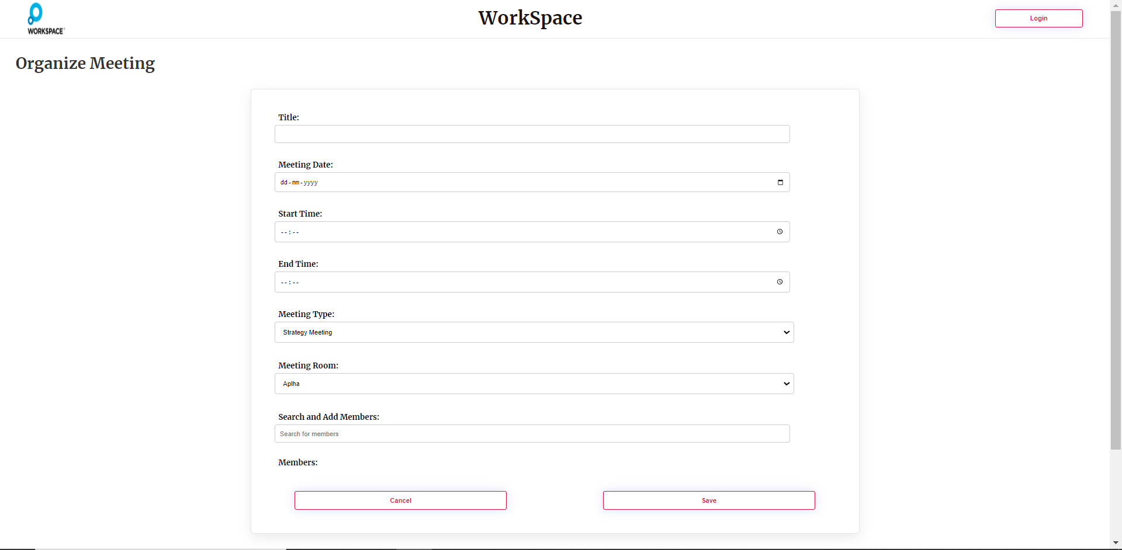
USER INTERFACE
(a) Login/SignUp
(b) Organize Meeting

Slide 11
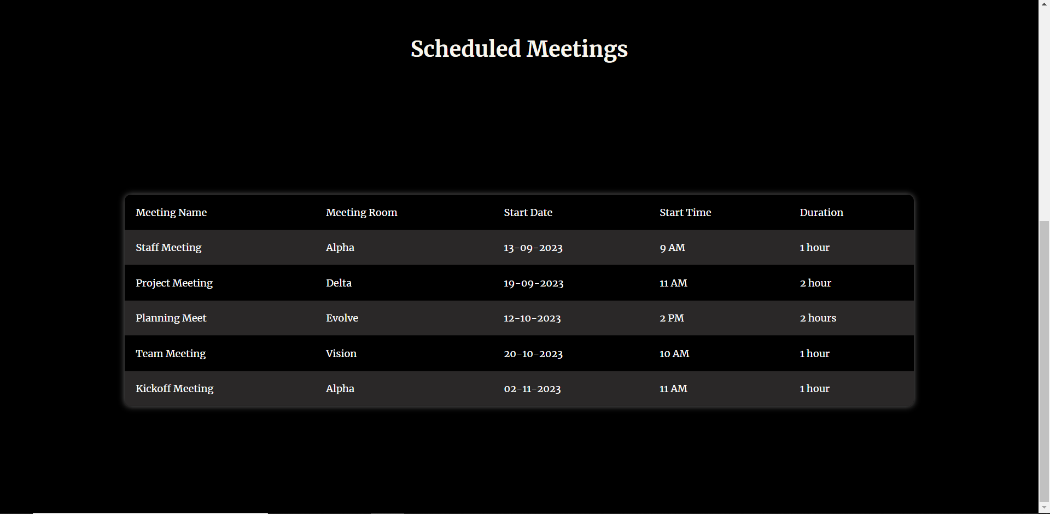
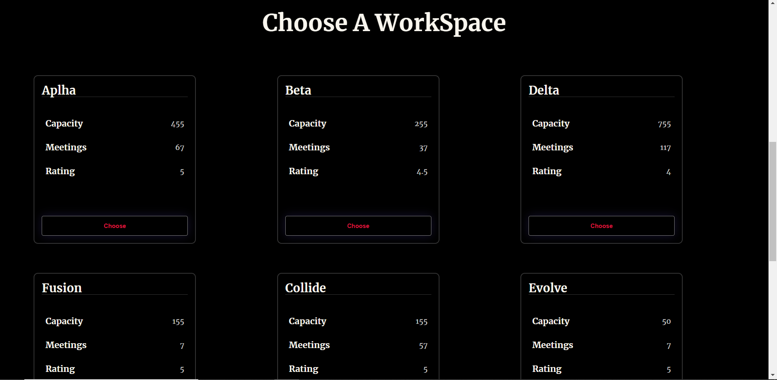
User Interface
(c) Scheduled Meetings
(d) Meeting Room Types

Slide 12
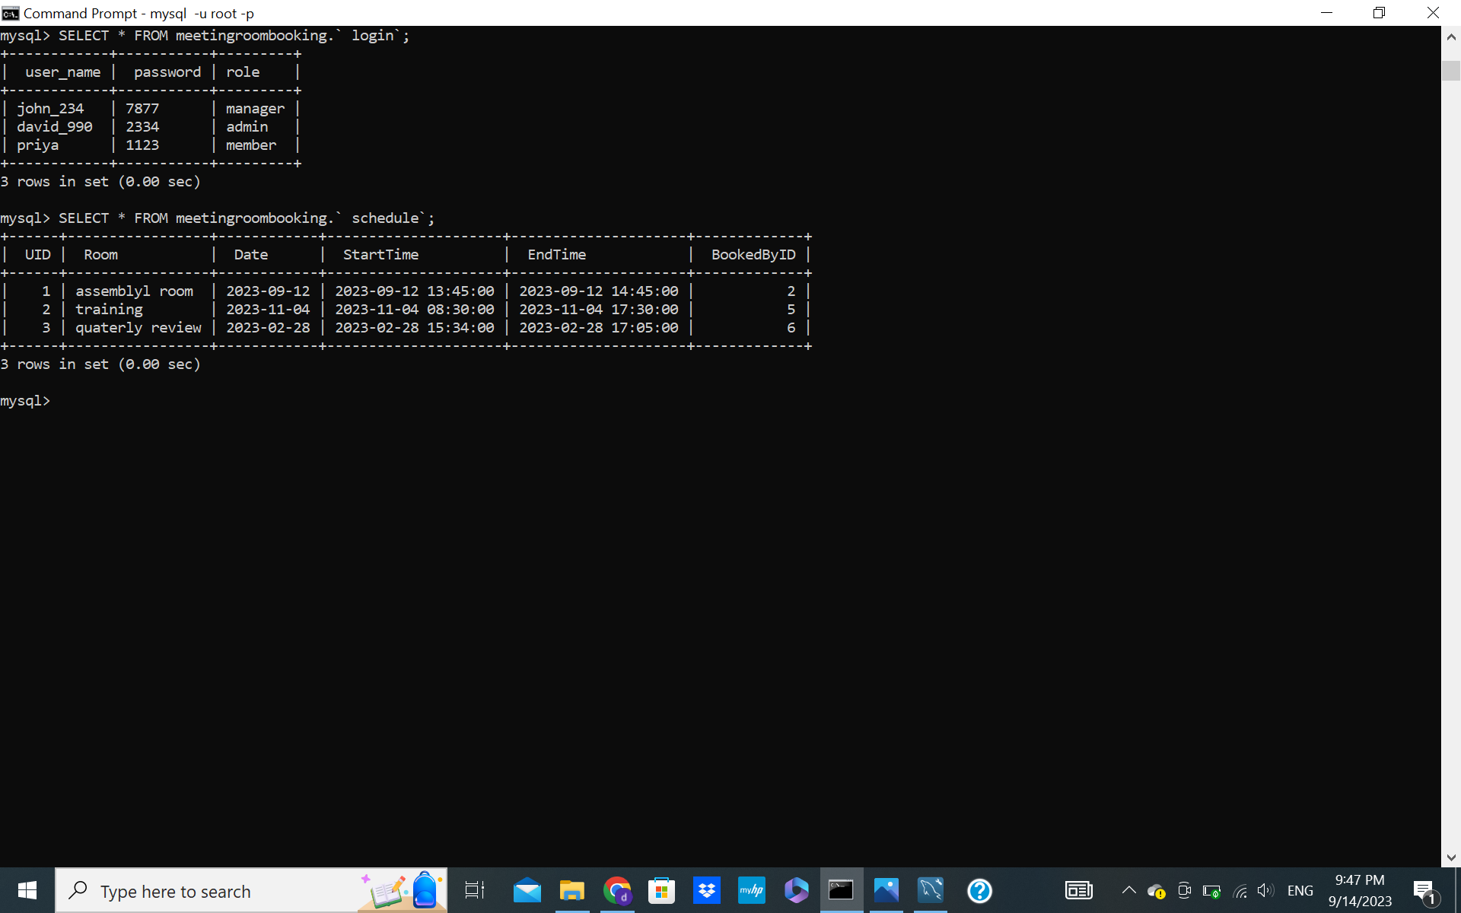
DATA STORAGE

Slide 13
UNIQUE FEATURE
Loose Coupling – We have minimized the dependencies between different components of our project. Loose coupling is desirable as it makes the system more flexible, maintainable, and easier to understand. It allows us to change one part of the system without affecting other parts. When a failure occurs in a loosely coupled system, it is less likely to propagate throughout the entire application. Failures can be isolated to specific components, making it easier to identify and address issues.

Slide 14
THANK YOU

